Slide 1
Home automation and security
Team member and responsibility
Ntando Mniki – Project Manager
Joseph Lumbahe – Hardware Technician
Promise Masango – HardwareTechnician
Liyakhanya Candy Tabata – Frontend Developer
Ali Myataza – Backend Developer
Onke Cetywayo - Business Analyst

Slide 2
Project overview
SOFTWARE
ENGINEERING
HUMAN
COMPUTER
INTERACTION
DATABASE

Slide 3
Human computer interaction
QUESTIONNARE
How we designed the interface
PROTOTYPE
FEEDBACK
DEPLOYMENT

Slide 4
Database overview
components
How it works
USER
LIGHT SENSOR
MOTION
ROOM
CAMERA
LIGHT
SENSORS
TAKE PHOTO
TEMPERATURE
EVENTS
DATABASE
SEND NOTIFICATION
TEMP>20
TEMP>40

Slide 5
SOFTWARE ENGINEERING
REQUIREMENTS
How we designed the whole product
DESIGN
IMPLEMENTATION
VERIFICATION
Notes:
Time management

Slide 6
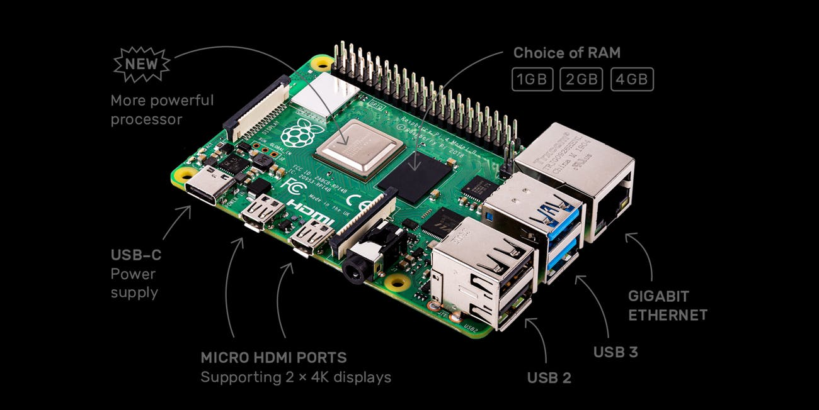
Conclusion

